Slide 1

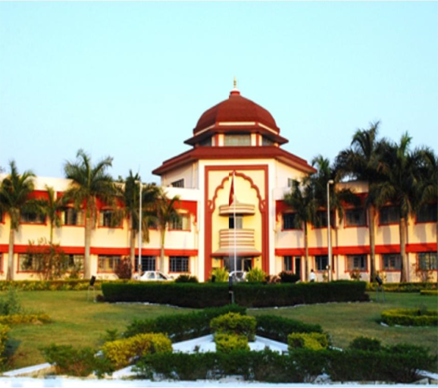


Army Institute of Technology Pune
Presents
PACE - 2020
RISE AS ONE

Slide 2

ARMY INSTITUTE OF TECHNOLOGY, PUNE
AIT is an undergraduate engineering college affiliated to the University of Pune.
AIT is located at Dighi Hills, Alandi Road area in Pune.
Only wards of army personnel are allowed admission. The admission is done through JEE MAINS exam.
AIT functions under the aegis of the Army Welfare Education Society (AWES) and has the senior most officer of the Indian Army, the Chief of Army Staff of the Indian Army (COAS), as the President of its Board of Governors.
True to its name the college has
Witnessed a huge upliftment
which can be attributed to the
sports fest that takes place
annually wherein students within the college as well as from other colleges take part with absolute gush and enthusiasm. The events are designed to test every face of physical fitness and skills. The two major sports fests.
AAKRITI (Intra college)
PACE

Slide 3
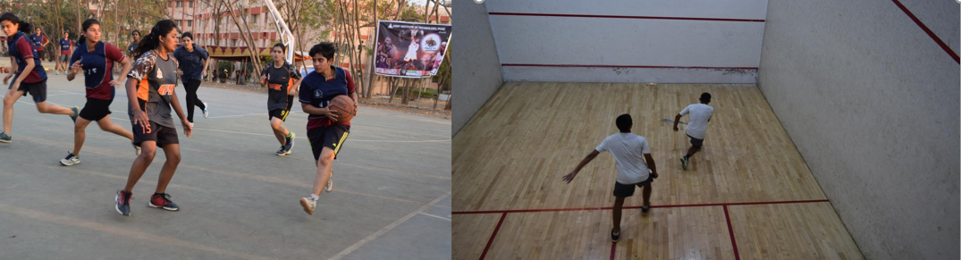
"We are what we repeatedly do. Excellence, then, is not an act, but a habit." This is not just a sentence but a synonym for PACE 2020.
Army Institute of Technology, known city wide for its exemplary fest brings yet another year of adrenaline rush, an era of participation that will enrapture students for eons to come.
Pace’20 , scheduled in the 3rd WEEK of February aims at ensuring a competitive environment among the students of Pune by encapsulating myriads of events.

Slide 4
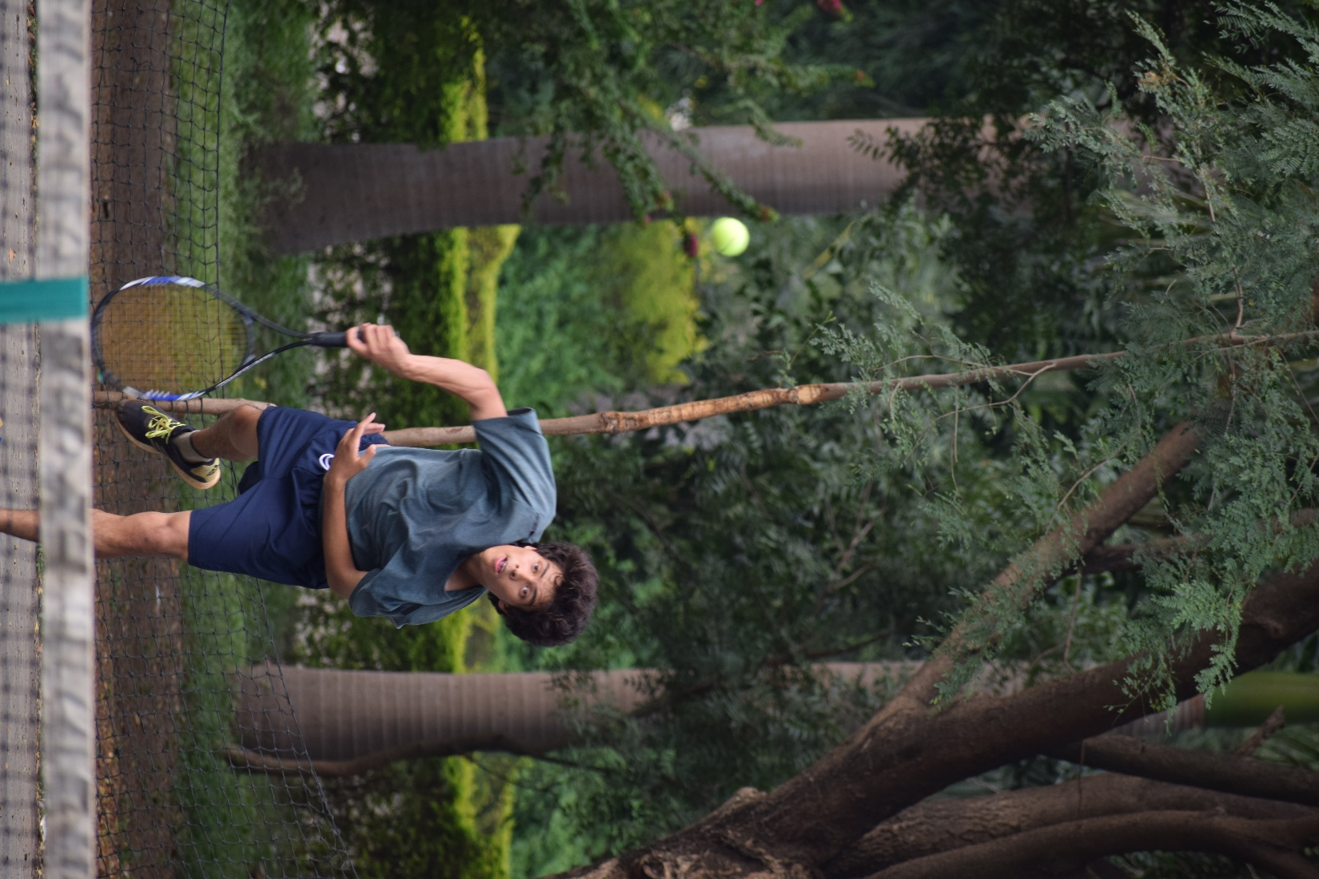

OUR THEME FOR 2020 IS “RISE AS ONE ”
IN A SPAN OF FOUR DAYS, WE HAVE SEVERAL EVENTS TOGETHER THAT PROMISE TO KEEP YOU ENGROSSED EVEN IN TIMES OF EXHAUSTION, TURMIL AND FRET. IF YOU HAVE BEEN UNDERVALUED BY SOMEONE , ITS JUST THE RIGHT PLATFORM TO SHOW YOUR SKILLS.
RISE AS ONE
Games and sports are not only important for success in studies but it is important for success in every phase of our life. Games and sports include all outdoor and indoor games and also athletics. In ancient Greece they formed the principal part of education. In the advanced countries of the present day also they are a regular feature of the school and college curriculum.

Slide 5
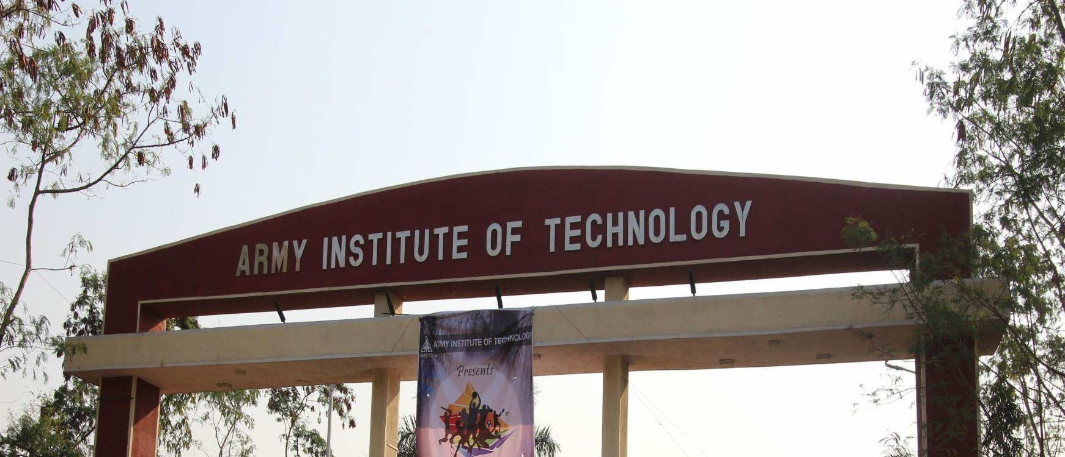
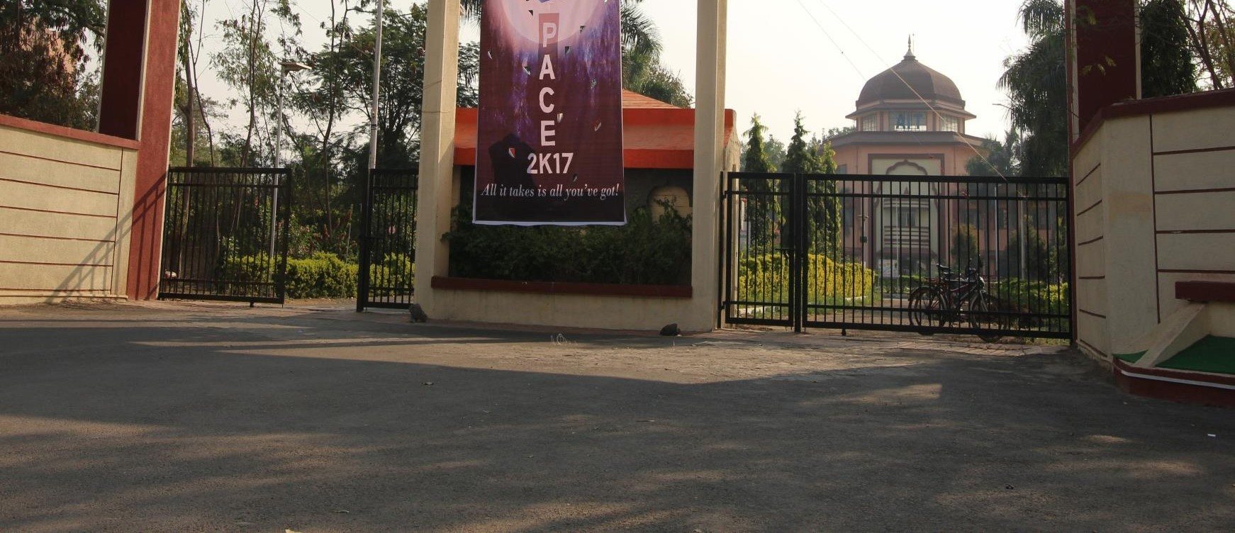
47
Colleges
Mainly targeted audience are students from colleges in and around Pune.
Pentagonal fight between NDA, CME, AFMC, AIT,
BEG attract other college students to come, spectate and cheer for the best!
5000
Students
3
Different Cities

Slide 6
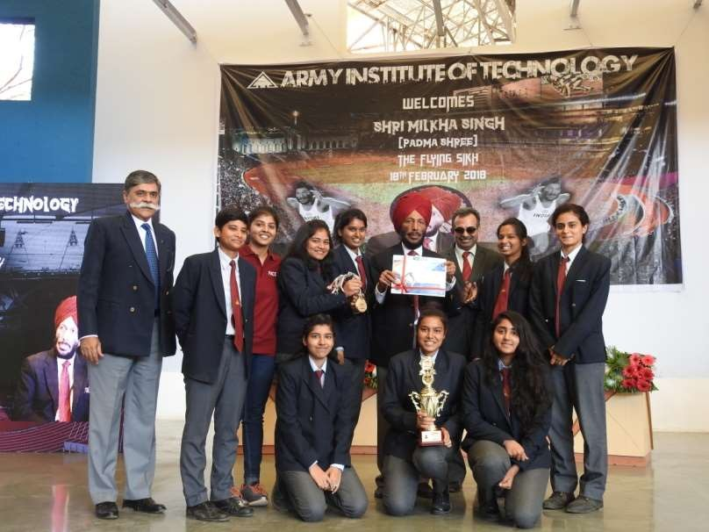
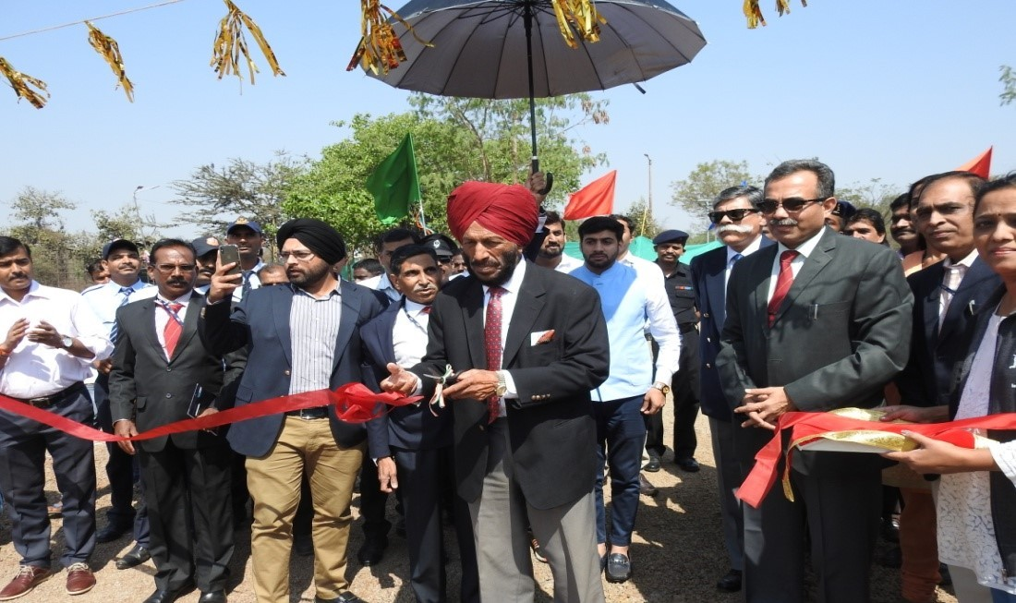
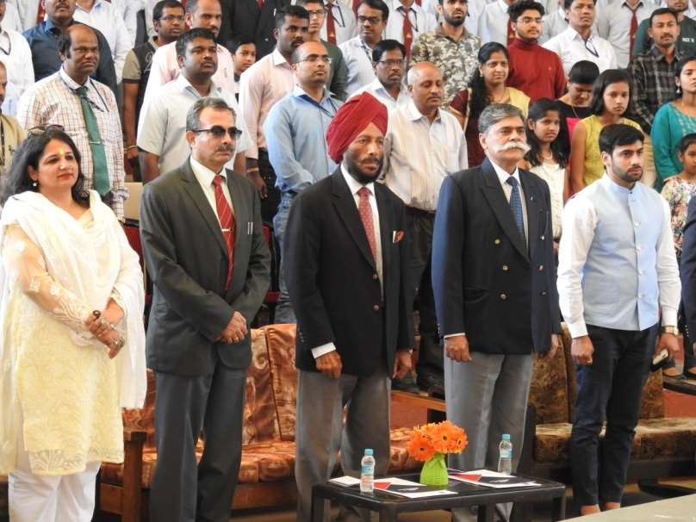
CHIEF GUEST 2018: PADMA SHRI MILKHA SINGH JI
“The Flying Sikh”
Padma Shri Milkha Singh Ji visited Army Institute of Technology as the chief guest of PACE 2018
He inaugurated an 8km marathon which was organised as a fund raiser for war widows and AWWA
He addressed the students and enlightened them with his words of wisdom and motivating them to contribute towards the glory of the country.

Slide 7
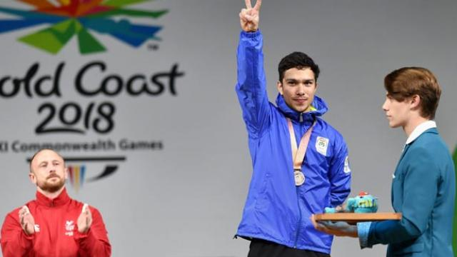
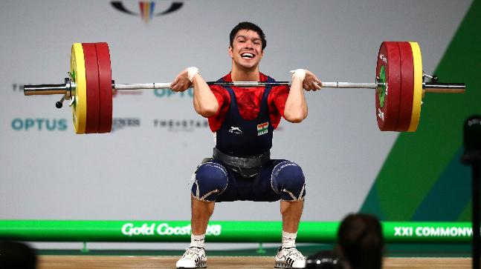
Chief Guest 2019: Deepak Lather
He won the bronze medal in the men's 69 kg weight class at the 2018 Commonwealth Games in Gold Coast, Australia.
He is the youngest person to hold an Indian national record in weightlifting.
He is a Naib Subedar in Bombay Sappers in the Indian Army.

Slide 8
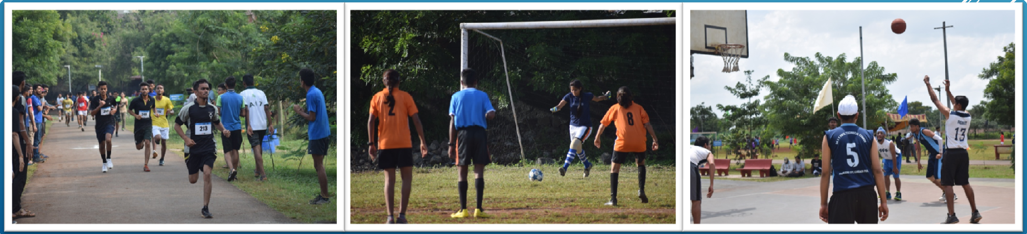
PACE: The annual sports fest of ARMY INSTITUTE of TECHNOLOGY, PUNE is one of the largest of its kind in PUNE. It is complete package of energy spread over four days.
PACE is an annual level sports meet held in AIT every year. Colleges from all over Pune participate in the fest every year with more than 4000 participants taking part. Teams from prestigious institutes like AFMC, CME, NDA, BEG, INA also grace the event with their presence.
The fest attracts thousands of visitors to the campus annually. PACE has grown leaps and bounds over the years and has consistently attracted participants from all over India. It has been living up to the expectations of participants who come here looking forward to the best events of their kind.

Slide 9
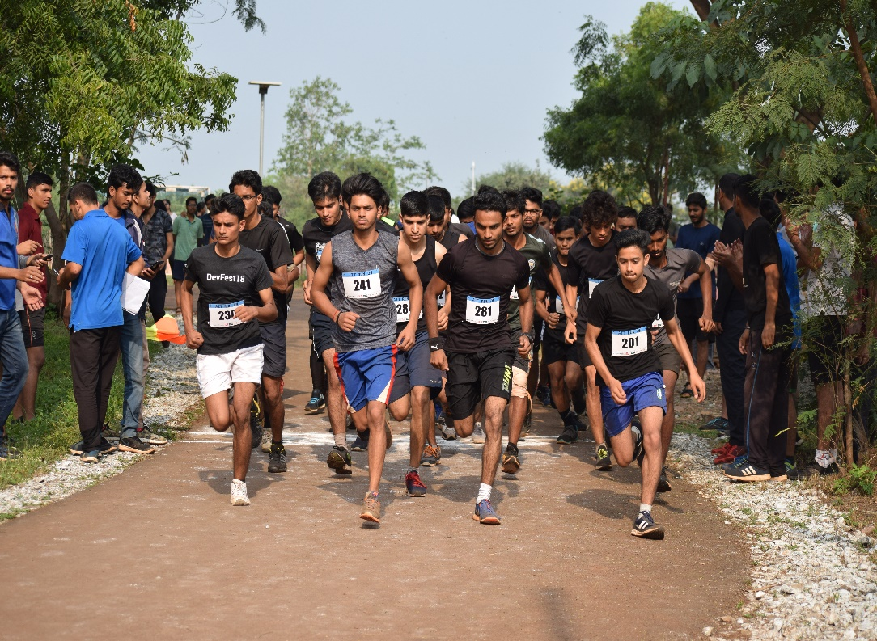
RUN ON
This year as well we will organise a 8km marathon. The aim of this marathon will be to support the war widows. The amount raised by registrations will be donated to the AWWA.

Slide 10
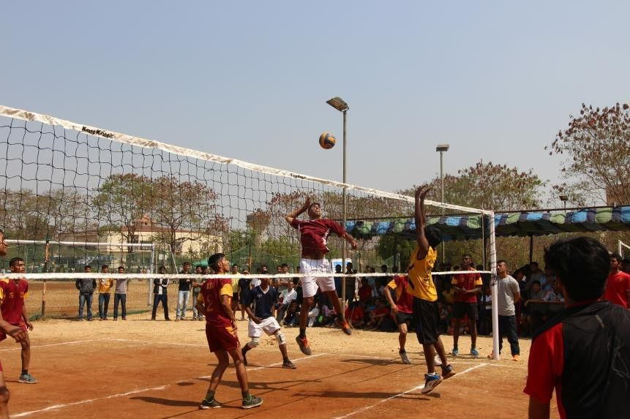
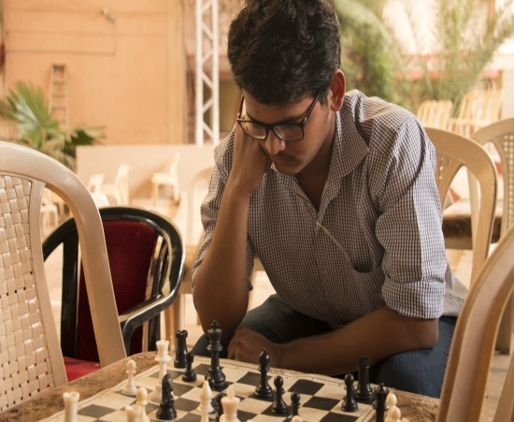
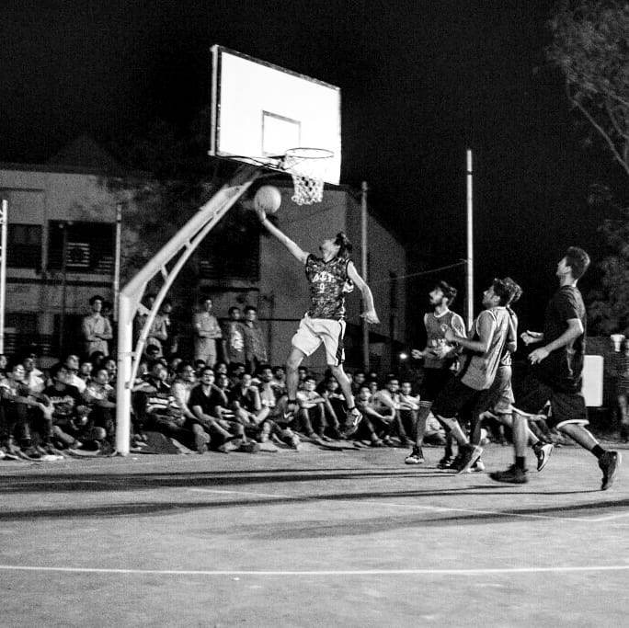
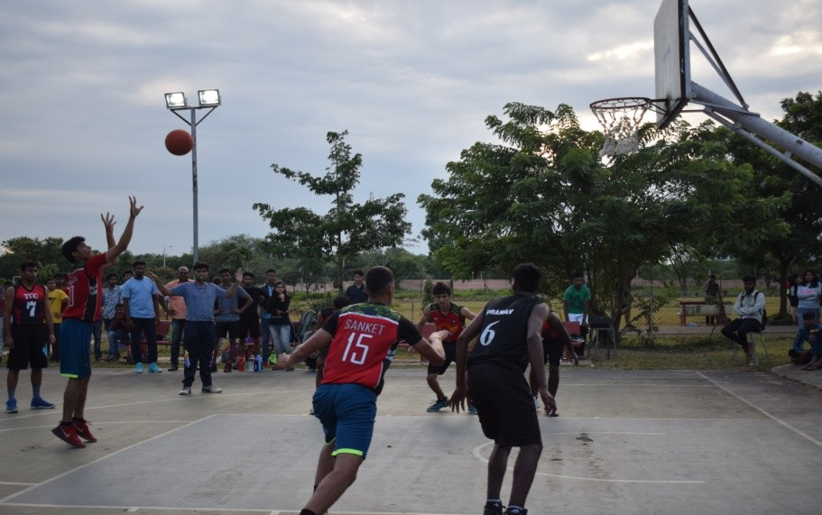
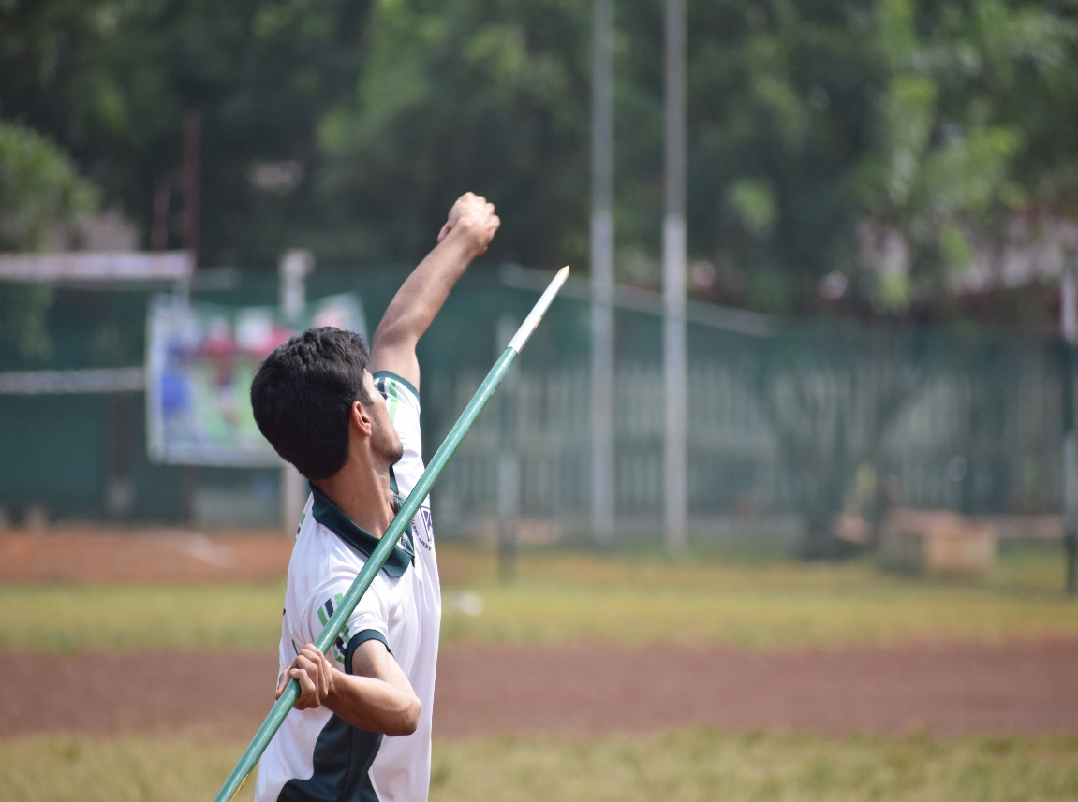
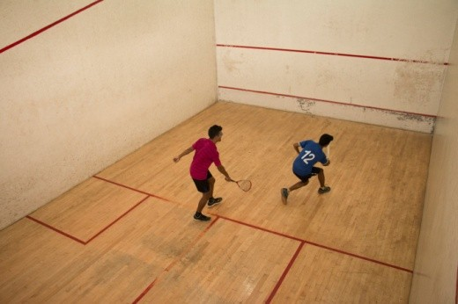

Slide 11
GRAND THIS TIME
Prizes Worth Rs 2 Lakh+.
8 KM marathon will be organized.
29+ Events will be organized this year.
Football court renovated with new grass.
Basketball courts, Squash courts and Lawn Tennis court renovated.

Slide 12

Following are the detailed list of prize money for PACE’20 along with respective registration fees.
Sr. No. | Event | Reg. Fee (Boys) | Prize Money (Rs.) | Reg. Fee (Girls) | Prize Money (Rs.)
1 | Squash (Individual) | 300 | I-2000 II-1000 | 200 | DOR
2 | Squash (Team) | 600 | I-4000 II-2000 | -
3 | Volleyball | 1400 | I-10000 II-6000 | 800 | I-5000 II-3000
4 | Football (6 a side) | 1000 | I-6000 II-4000 | 600 | I-4000 II-2000
5 | Football (11a side) | 1400 | I-10000 II-6000 | -
6 | Lawn Tennis | 400 | I-2500 II-1500 | 200 | DOR
7 | Basketball | 1400 | I-10000 II-6000 | 800 | I-5000 II-3000
8 | Cricket | 2800 | I-18000 II-12000 | 600 | DOR

Slide 13
9 | Badminton (Individual) | 300 | I-2000 II-1000 | 200 | I-1200 II-800
10 | Badminton (Team) | 800 | I-5000 II-3000 | 400 | I-2500 II-1500
11 | Badminton (Mix) | - | - | 600 | I-3000 II-2000
12 | Table Tennis (Individual) | 200 | I-1500 II-1000 | 200 | I-1200 II-800
13 | Table Tennis (Team) | 300 | I-2000 II-1000 | 200 | I-1500 II-1000
14 | Chess (Individual) | 100 | I-1200 II-800 | 100 | I-1200 II-800
15 | Kabaddi | 1200 | I-8000 II-5000 | -
17 | KHO-KHO | 600 | I-4000 II-2000 | -
18 | MARATHON Mix(8 KM) | 200 | I-5000 II-3000 III-2000 | 200 | DOR

Slide 14
Contact Us
POOJA KUDALE: 7038450512
sports@aitpune.edu.in
aitsportsclub.com
Ig-aitsportsclub
KUMIT YADAV:
8272896950
Notes:
S

Slide 15
THANK YOU

